Slide 1
Unit 10: For Live Session Assignment

Slide 2
Part 1: Quick Quiz Questions

Slide 3
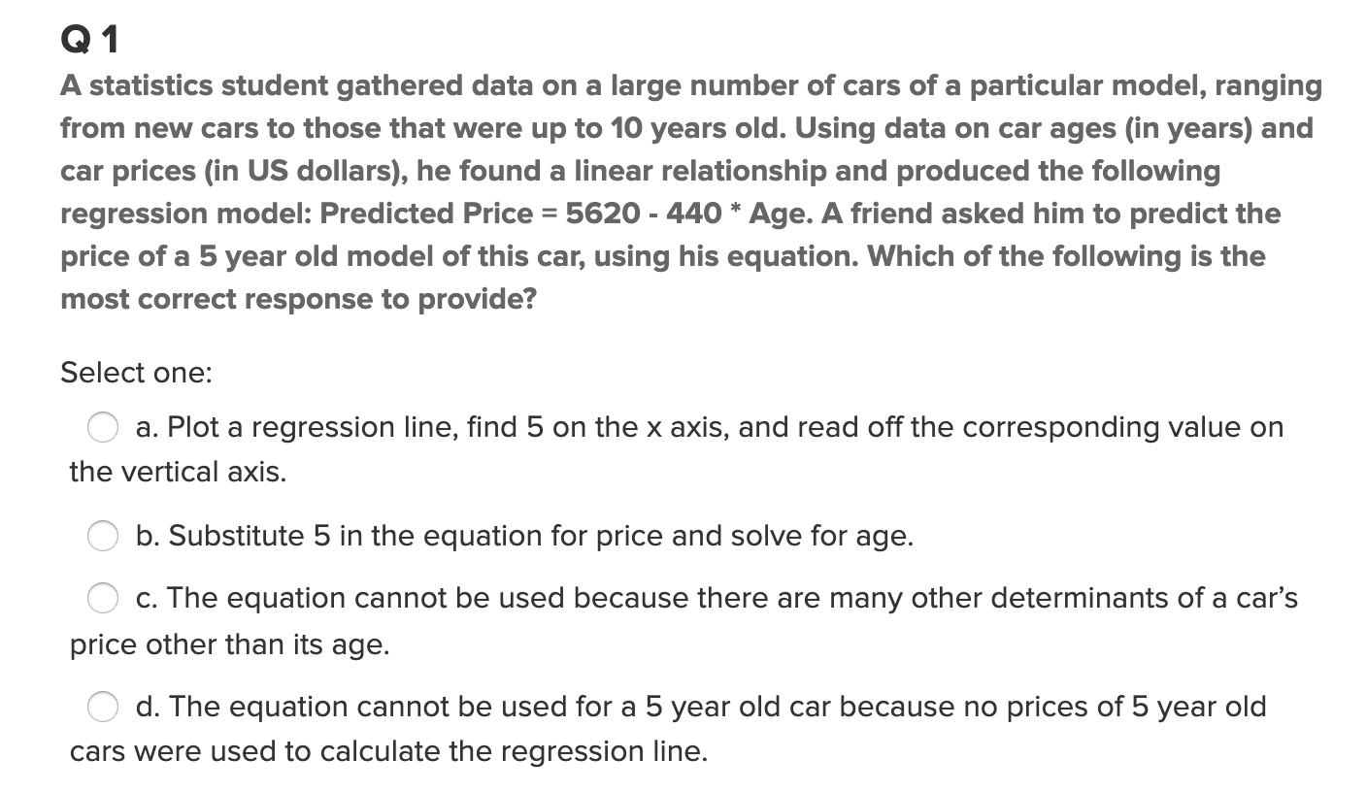
Part 1: Quick Quiz Questions

Slide 4
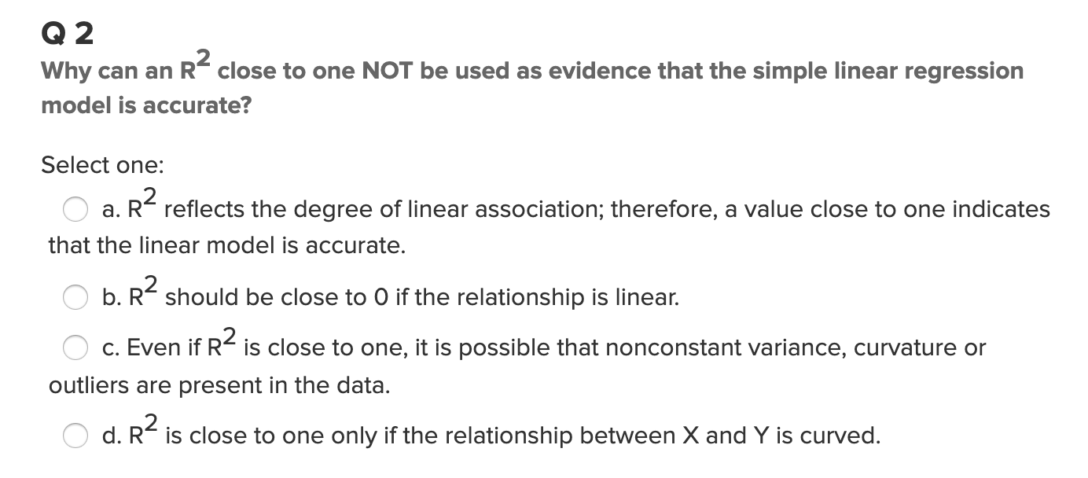
Part 1: Quick Quiz Questions

Slide 5
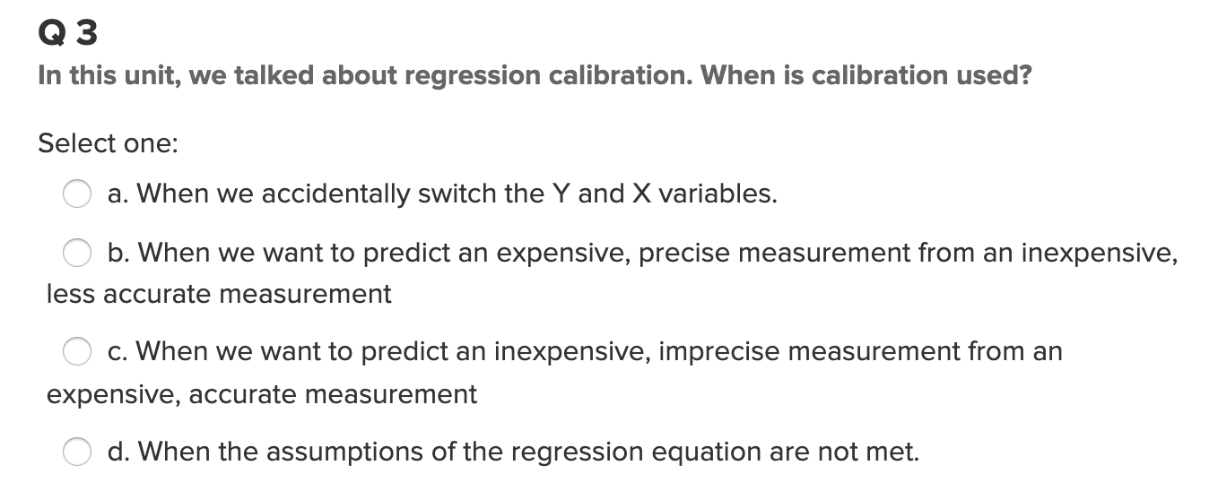
Part 1: Quick Quiz Questions

Slide 6
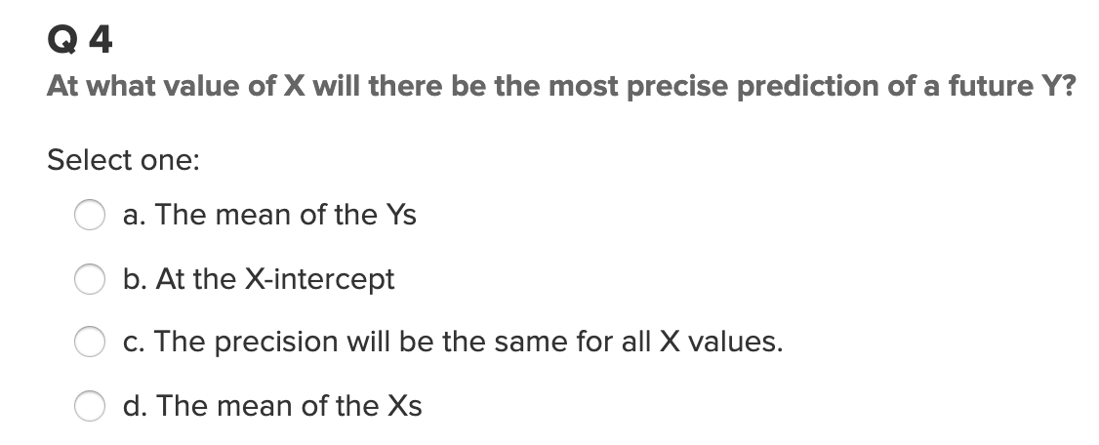
Part 1: Quick Quiz Questions

Slide 7
Part 2: Lack of Fit Test

Slide 8
Lack of Fit Test
Month | Sales
1 | 2.678969
1 | 6.452194
1 | 1.837394
1 | 6.108601
1 | 5.369281
2 | 1.766862
2 | 6.898837
2 | 1.579677
2 | 3.726494
2 | 8.953184
3 | 8.680436
3 | 9.931636
3 | 6.691443
3 | 11.39723
3 | 14.93447
A company wants to look at sales volume (in $M) for various stores for three different months. Perform a lack of fit test (at significance level 0.05) to determine if the separate means model (using three parameters) is significantly better than the linear regression model (using two parameters).
You may want to copy the blank ANOVA table on paper.
DO NOT plug the data into any software.
Source | df | SS | MS | F | Pr > F
^{Model} | 1 | 26.5673 | 26.5673 | 3.2407 | 0.097
_{Error} | 12 | 98.16409 | 8.1803
_{Total} | 13 | 124.7314

Slide 9
Part 3: Takeaways

Slide 10
Please Provide a summary of at least 4, but as many any as you like, takeaways from this unit!

Slide 11
Takeaways
Practice with the ANOVA table is key, they’re sometimes tricky. Especially this one from the live session, the non aligned columns threw me off!
Question 4 on the quick quiz questions took some thought. And I’m still not sure.
Calibration is still very murky to me, is it correct to say we use calibration is used to essentially swap variables (with a few more details)? However, I’ve also seen other definitions where calibration is used to correct bias. These two definitions and their relationship is murky. Maybe one strictly involves regression, and the other doesn’t.
A takeaway is that I really enjoy regression. In undergrad I took an entire 3 credit course on it, so I’ve previously learned lots! It’s a great fundamental statistical skill!
Hopefully, the next exam, there’s lots of regression! (Potential for redemption)

Slide 12
Part 4: Questions or Comments

